Slide 1



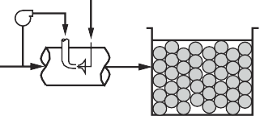
736
11 Granular Filtration
Conventional filtration.
Most common filtration system. Used with any surface water, even those with very high or variable turbidity. Responds well to rapid changes in source water quality.
Coagulant Flocculation
Sedimentation Filtration
Mixing
Direct filtration.
Good for surface waters without high or variable turbidity. Typical source waters are lakes and reservoirs, but usually not rivers. Raw-water turbidity < 15 NTU.
Coagulant Flocculation
Filtration
Mixing
In-line filtration (also called contact filtration).
Requires high-quality surface water with very little variation and no clay or sediment particles. Raw-water turbidity < 10 NTU.
Coagulant
Filtration
Mixing
Two-stage filtration.
Preengineered systems used in small treatment plants (also called package plants). Raw-water turbidity < 100 NTU.
Coagulant
Roughing filter
Filtration
Mixing
Figure 11-3
Classiﬁcation of rapid ﬁltration by pretreatment level.

